Slide 1
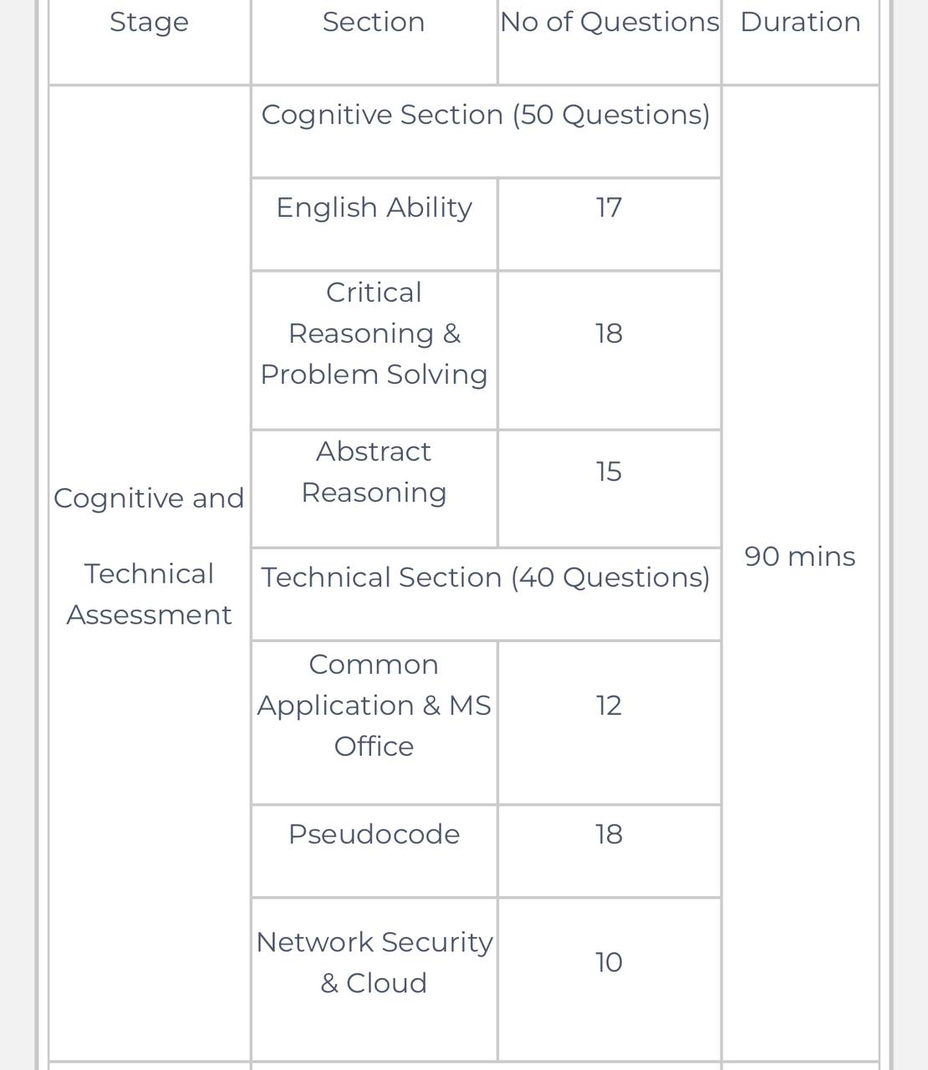
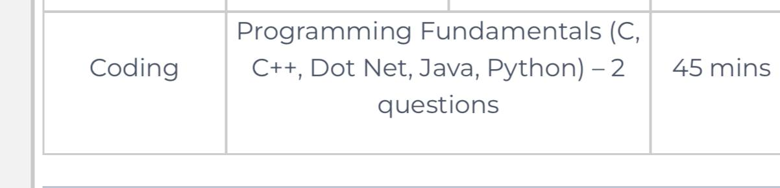
Accenture Test Pattern

Slide 2
Accenture Syllabus
Accenture Common Applications & MS Office Syllabus
• MS Office (Word, PowerPoint, Excel, Outlook)
• Browsers' fundamentals
• Shortcut keys
• Command prompt
• Working flow of keys
Accenture Network Security Syllabus
• Basics of Networking
• Network Security
• Encryption standards & Algorithms
• Network security devices
• Attack types
Accenture Cloud Syllabus
• Fundamentals of Cloud Computing
• Client server architecture
• Cloud data centers
• Cloud service providers
• Cloud Service Platforms

Slide 3
Accenture Syllabus
Accenture Pseudocode Syllabus
• Programming Fundamentals
• Looping
• Arrays
• Recursion
• Function
• Bitwise Operators
• Increment & Decrement Operators
• Conditional statements
• Basics of Data Structures
Accenture Coding Syllabus
• Basics of Programming
• Input & Output Concepts
• Flow Control
• Conditional Looping
• Arrays
• Functions
• Strings
• Data types & Operators

Slide 4
Accenture Pseudo Codes
What operation does the following pseudocode perform?
Declare an array "word" of string data type
Declare a variable l
Take a string as input in the word
for l = 0 to 0
print word[l]
End for
Algorithm End
a) It prints characters in increasing order
b) It prints the first character of the string
c) It reverses the string

Slide 5
Accenture Pseudo Codes
Integer x, y, z
Set x = -2, y = 3, z = 1
if(x + (2 & 2) && y + (3 & 3) && z + (2 ^ 2)) a) 2 b) 11 c) 3 d)0
x = x - 2
y = x
Else
x = z
y = y ^ 2
End if
Print x+ y+ z

Slide 6
Accenture Pseudo Codes
Integer p, q, r, sum
Read p, q, r
Set sum = p + q + r
if ((p NOT EQUALS 0) and (sum EQUALS 11) and (q EQUALS 4) and (r NOT EQUALS 0))
Print " Success"
Otherwise
Print "Fail"
End if
p=3 q=8 r=1
Sucess 2) Fail 3) error 4) None of thesee

Slide 7
Accenture Pseudo Codes
Predict the output of the following pseudocode for n = 5, m = 6.
Integer solve(Integer n, Integer m )
if(n > 4 && m < 7)
return solve(n +1, m + 1)
Else
Return n + m
End if
End function solve()
15 b) 21 c) 13 d) 10

Slide 8
Accenture Pseudo Codes
5) Initialize i, n=5
Set arr[]= 1, 2, 3, 4, 5
for i = 0 to n - 2
arr[i] = arr[i] + arr[i+1]
End for
Print elements of array
3 3 4 9 5
4 3 7 5 2
3 5 7 9 5
1 2 3 4 5

Slide 9
Accenture Pseudo Codes
6) Integer x, y, z
Set x = 0, y = 3, z = 11
if(x + (1 | 2) && y + (2 | 3))
x = x - 2
y = x
Else
x = z
y = y ^ 2
End if
Print x + y + z
15
10
13
7

Slide 10
Accenture Pseudo Codes
7) Initialize i, n
Initialize an array of size n
Take the values for the array
for i = 0 to n - 2
arr[i] = arr[i] - arr[i+1]
End for
3 3 4 9 5
1 1 1 1 1
3 5 7 9 5
2 2 2 2 2

Slide 11
Accenture Pseudo Codes
8) Integer x, y, z
Set x = 10, y = 16,z = 3
if(x > y)
x = 2 * y
Else
y = x / 2
End if
if(z > y)
z = 2 * y
Else
y = z / 2
End if
Print x + y + z
38
20
33
14

Slide 12
Accenture Pseudo Codes
9) Initialize i, n=5
Set arr[]= 1, 2, 3, 4, 5
for i = 0 to n - 2
arr[i] = arr[i] * arr[i+1]
End for
Print elements of array
10 12 8 2 1
20 12 6 2 1
5 10 6 2 0
20 4 6 1 1

Slide 13
Accenture Pseudo Codes
10) What is the output for x=9 and y=7
Integer funn(Integer x, Integer y)
Integer z
Set z = 2
y = y mod z
x = x mod z
return x + y
End function funn()
2
3
17
5

Slide 14
Accenture Technical MCQ
11) Which of following is not a operating system
Macos
Linux
Windows
Microsoft Edge

Slide 15
Accenture Technical MCQ
12) What does the formula= LEN(“I love Mettl”) will return?
Name Error
Reference Error
12
10

Slide 16
Accenture Technical MCQ
13) Which of the following functions will you use to extract month from a date given in a cell in MS
CURRENTMONTH()
DATE()
DAY()
MONTH()

Slide 17
Accenture Technical MCQ
14) IF you want that all the numbers between the 0 and 50 in a range should be displayed in blue color you should perform which of the following operations?
Select the numbers in range from 0-50 and color it blue
Use if function
Apply condition formatting
All of the above

Slide 18
Accenture Technical MCQ
15) Starting with Microsoft Office 2003, Photo Editor was renamed to :
A. Manager
B. Picture Manager
C. Picture Editor
D. Paint Editor
Answer : Option B

Slide 19
Accenture Technical MCQ
16) A feature of MS Office that saves the document automatically after certain interval is called ____
A. Web Page
B. Explorer
C. FrontPage
D. DreamWeaver
Answer : Option C

Slide 20
Accenture Technical MCQ
17) Which feature is used to make selected sentence to All Captital Letters or All Small Letters ?
A. Change Letter
B. Change Sentence
C. Change Case
D. Change Word
Answer : Option C

Slide 21
Accenture Technical MCQ
18) Which of these software applications was not part of the first version of Microsoft Office?
A. Paint
B. Outlook
C. PowerPoint
D. MS Word
Answer : Option B

Slide 22
Accenture Technical MCQ
19) Which of the following is the type of connection that helps us navigate from one slide to another slide in the same presentation and to a slide in another presentation?
A.Footer
B.Header
C.Hyperlink
D.Attachment
Answer : Option C

Slide 23
Accenture Technical MCQ
20) Which of the following can be used to close a tab on a browser?
A.Ctrl+T
B.Ctrl+A
C.Ctrl+W
D.Ctrl+X
Answer : Option C

Slide 24
Accenture Technical MCQ
21)
What is the full form of OSI?
a) optical service implementation
b) open service Internet
c) open system interconnection
d) operating system interface

Slide 25
Accenture Technical MCQ
22) How many layers are there in the ISO OSI reference model?
a) 7
b) 5
c) 4
d) 6

Slide 26
Accenture Technical MCQ
23) What are nodes in a computer network?
a) the computer that routes the data
b) the computer that terminates the data
c) the computer that originates the data
d) all of the mentioned

Slide 27
Accenture Technical MCQ
24) Which of the following maintains the Domain Name System?
a) a single server
b) a single computer
c) distributed database system
d) none of the mentioned

Slide 28
Accenture Technical MCQ
25) What is the term for the data communication system within a building or campus?
a) MAN
b) LAN
c) PAN
d) WAN

Slide 29
Accenture Technical MCQ
26) What was the name of the first network?
a) ASAPNET
b) ARPANET
c) CNNET
d) NSFNET

Slide 30
Accenture Technical MCQ
27) Which network topology requires a central controller or hub?
a) Ring
b) Bus
c) Star
d) Mesh

Slide 31
Accenture Technical MCQ
28) When collection of various computers seems a single coherent system to its client, then it is called _________
a) computer network
b) distributed system
c) networking system
d) mail system

Slide 32
Accenture Technical MCQ
29) Which of the following computer networks is built on the top of another network?
a) prior network
b) chief network
c) prime network
d) overlay network

Slide 33
Accenture Technical MCQ
30) What is the full form of TCP/IP
Transmission control Protocol
Transfer control Protocol
Traffic control Protocol
Transmission control Pipe.

Slide 34
Accenture Technical MCQ
31) Which of the following is an application monitoring and observability service?
Amazon EC2
Amazon Route 53
Amazon ElasticCache
Amazon CloudWatch

Slide 35
Accenture Technical MCQ
32) Which of the following metric shows the ratio of time a system or component is functional to the total time it is required or expected to function?
Reliability time
Response time
Service time
Throughput time

Slide 36
Accenture Technical MCQ
33) Which is the major factor/most important in Cloud computing services?
Web services
Softwares
All of the above
Internet

Slide 37
Accenture Technical MCQ
34) Which of the following is not a type of cloud server?
a) Public Cloud Servers
b) Private Cloud Servers
c) Hybrid Cloud Servers
d) Merged Cloud Servers

Slide 38
Accenture Technical MCQ
35) Which of the following is a type of cloud computing service?
a) Service-as-a-Software (SaaS)
b) Software-and-a-Server (SaaS)
c) Software-as-a-Service (SaaS)
d) Software-as-a-Server (SaaS)

Slide 39
Accenture Technical MCQ
36) Which of the following is the application of cloud computing?
a) Adobe
b) Paypal
c) Google G Suite
d) All of the above

Slide 40
Accenture Technical MCQ
37) Which of the following is an example of the cloud?
a) Amazon Web Services (AWS)
b) Dropbox
c) Cisco WebEx
d) All of the above

Slide 41
Accenture Technical MCQ
38) Which of the following is an example of a PaaS cloud service?
a) Heroku
b) AWS Elastic Beanstalk
c) Windows Azure
d) All of the above

Slide 42
Accenture Technical MCQ
39) Which of the following is required by Cloud Computing?
a) That the identity be authenticated
b) That the authentication be portable
c) That you establish an identity
d) All of the mentioned

Slide 43
Accenture Technical MCQ
40) Cloud computing is a concept that involves pooling physical resources and offering them as which sort of resource?
a) cloud
b) real
c) virtual
d) none of the mentioned

